Slide 1
Adaptive Filterbanks using Autoencoders
Robert Viehweg

Slide 2
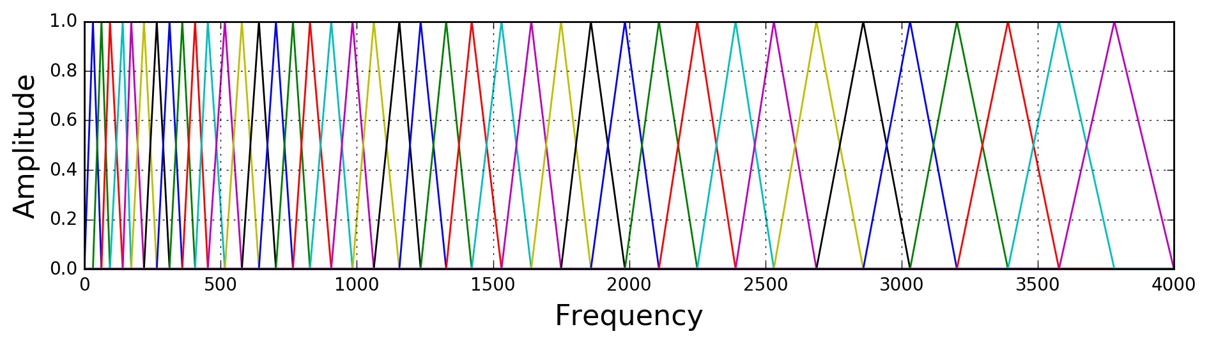
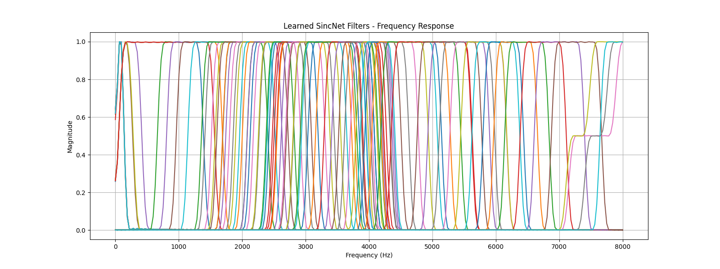
Fixed vs Adaptive Filterbanks
Fixed filterbanks for example Mel-Filterbank
    Drawback: not specialized for holistic audio tasks
Adaptive filterbanks, trained on specific data
    Advantage: highly adabdable for specific tasks

Slide 3
Project setup
Link SincNet adaptive filterbank to autoencoder architecture
Train model on speech data
Evaluate recreated audio
Train the same model on fixed Mel-Filterbank
Compare fixed and learned Filterbanks

Slide 4
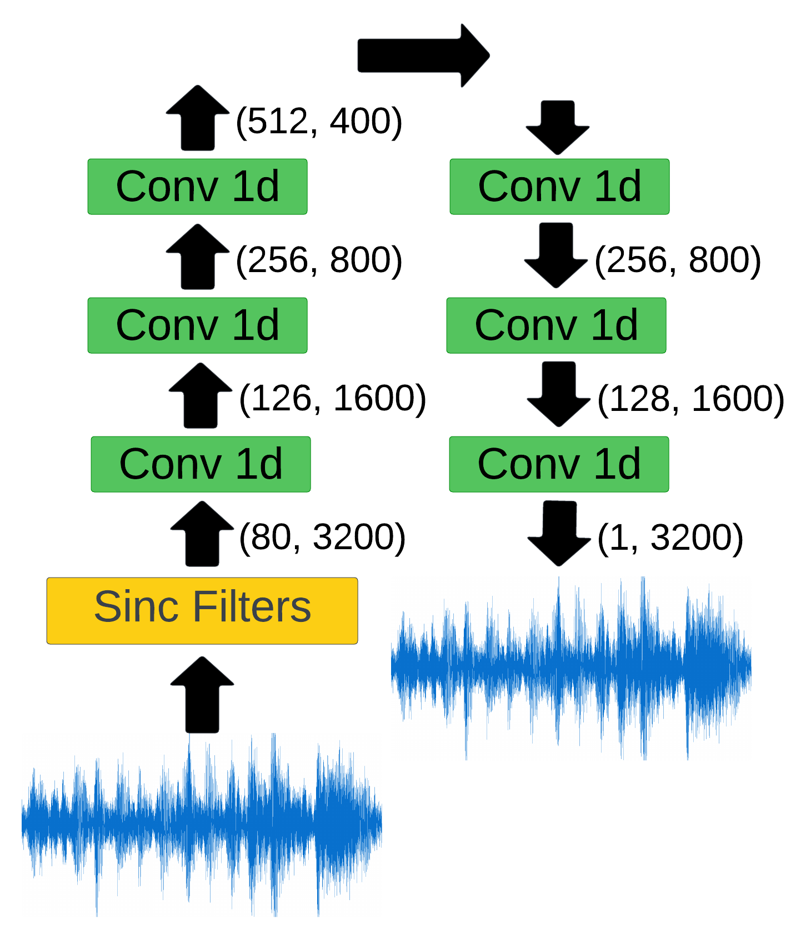
Models
Autoencoder:
SincNet Filters (80 filters of length 251 samples):
    Low and high cutoff frequencies learned during training

Slide 5
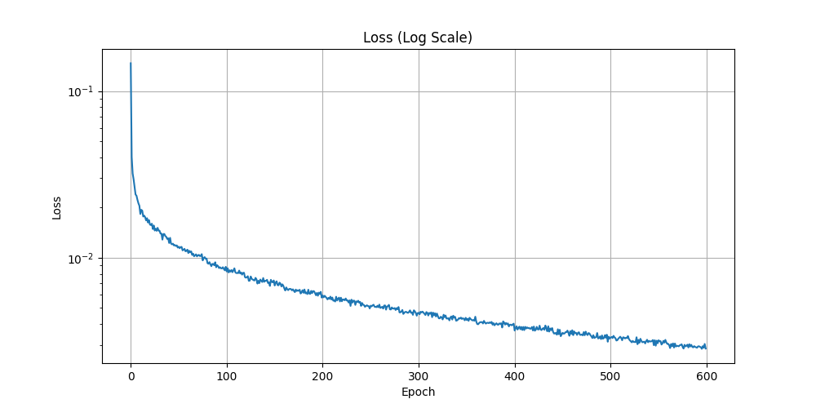
Training
Dataset: DAPRA TIMIT Acoustic-Phonetic Continuous Speech Corpus
    Random speech audio snippets of length 3200 samples
RMSprop optimizer trains both models to recreate the input audio snippet
    Learning rate scheduler
    MAE loss
    600 epochs (1h and 12 seconds)

Slide 6
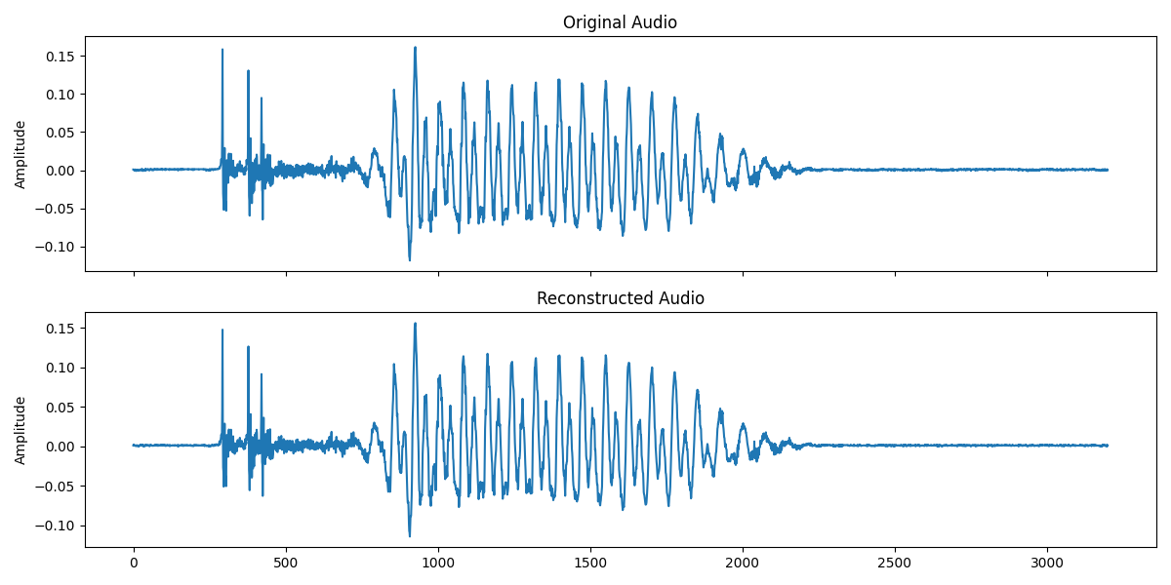
Audio Reproduction
Trained model achieved good audio reproduction
Learned Filterbank concentraded in the center frequencies (most prominent in speech)

Slide 7
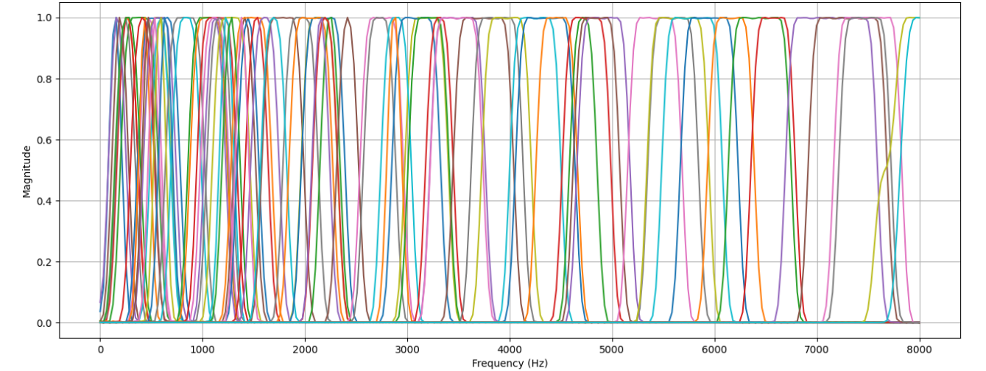
Comparison Fixed and Learned Filters
Second model trained with fixed Mel-scale Filterbank
Comparison by computing loss of output and input audio for both models 1000 times

Slide 8
Results
Average MAE fixed Filterbank: 0.00259
Average MAE adaptive Filterbank: 0.00215
The adaptive Filterbank achieved better audio reconstruction measured with MAE
    The reason could be highly specialized filters for speech data, while Mel-scale filters are more holistic

Slide 9
Discussion
MAE potentially not sufficient for capturing differences in audio as it is a purely time-domain approach
    Better alternative: Spectral Loss or Log-Magnitude Spectral Loss
Worth experimenting with other model architectures or modifications
    Upscaling of layers
    Increasing training time
Adaptive Filterbanks could also be trained on more holistic audio data to compare with fixed Mel-scale filterbank, which is adaptive to a wide field of audio tasks

